Slide 1

Credit Risk Model
Au Hong Yao Justin U2310037F
Lee Yew Joe U2322894G
FCED Team 7

Slide 2




Table Of Contents
1:Introduction
Problem Definition, Motivation & Dataset used
2:Data Preparation & EDA
Cleaning of data and initial data-driven insights
3:Machine Learning
Random Forest, Logistic Regression and TensorFlow
4:Conclusion
Outcome & Data Driven Insights
02

Slide 3


Motivation & Problem Statement
Problem Definition
How can we enhance the current credit risk models available such that the rate of payments defaulting decreases significantly?
What are some of the contributing factors to this risk levels of loaners?
Motivation
Loans are increasingly more common. However, there has been an significant increase in loan defaults too.

Slide 4
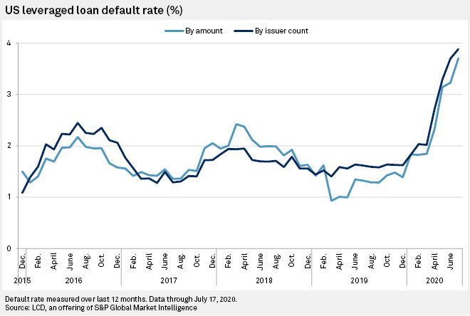


Motivation
Rate at which loan default are increasing poses a significant issue to banks and the ecnonomy itself
Aim is to refine the models available such that loan takers risk are carefully analysed before approving their loan

Slide 5


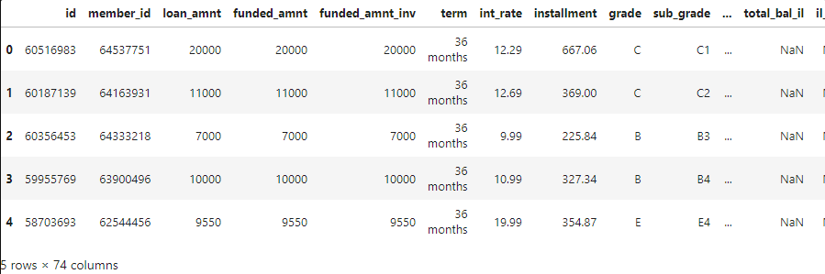
Loan Dataset
Variables
Data Points
Loan Amount
Interest Rate
Monthly Income
...many more!
421,094 Rows
74 Columns

Slide 6


2: Data Preparations
Dropping rows that are null
Re-Categorize values in ‘loan_status’
Dropping columns

Slide 7
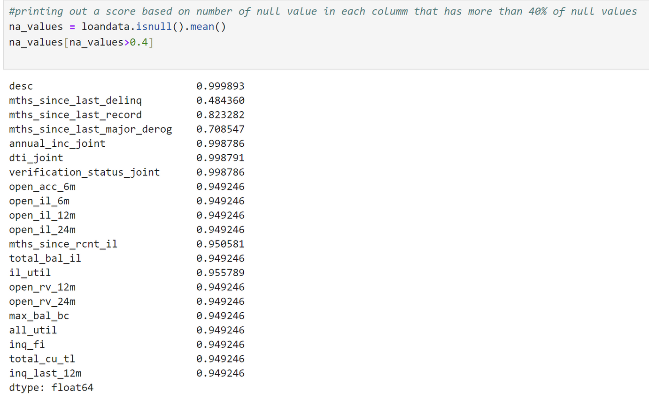
Data Preparation
Dropping these columns as they have too much empty rows

Slide 8
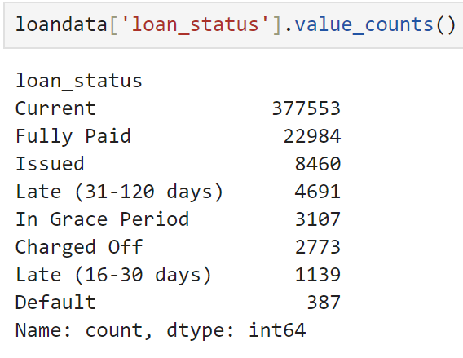
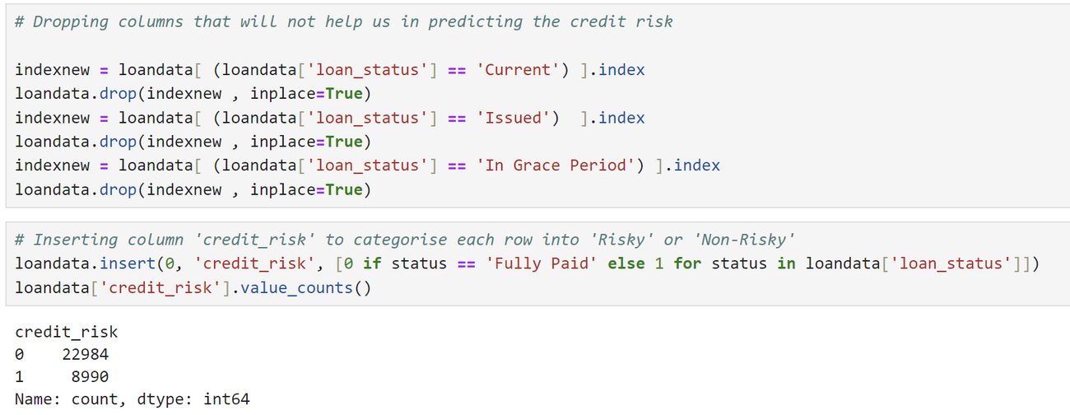

Data Preparation
We decided to drop rows such as “Current/In Grace Period /Issued” and re categorize the remaining into risk and non-risky under “credit_risk”

Slide 9
2: EDA
Chi Square Test
Plotting and Pattern observation of graphs

Slide 10
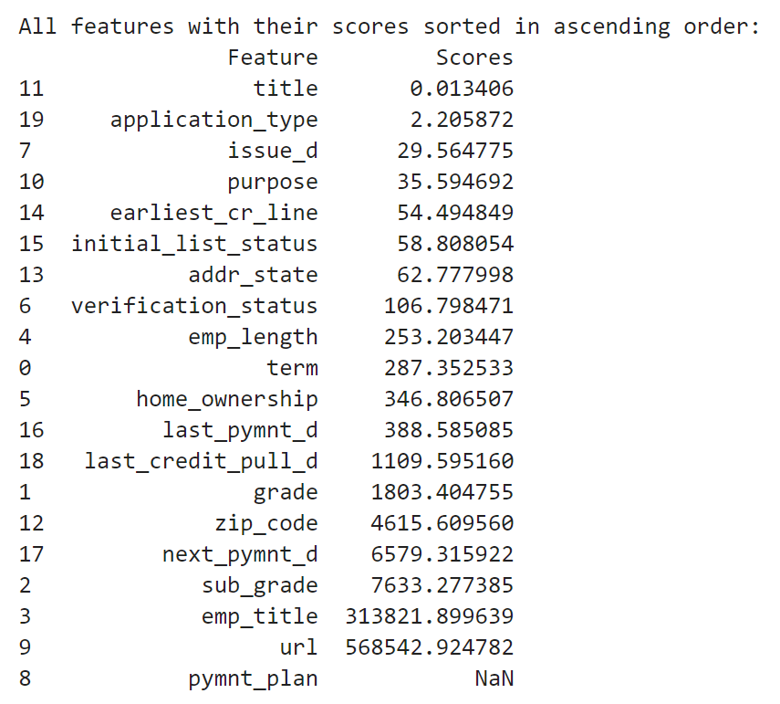
EDA
Based on the Chi Square Test, we decided to drop variable with chi score less than 100 as they do not make good predictors for our response variable

Slide 11
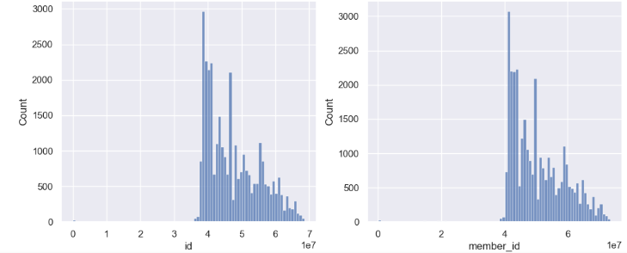

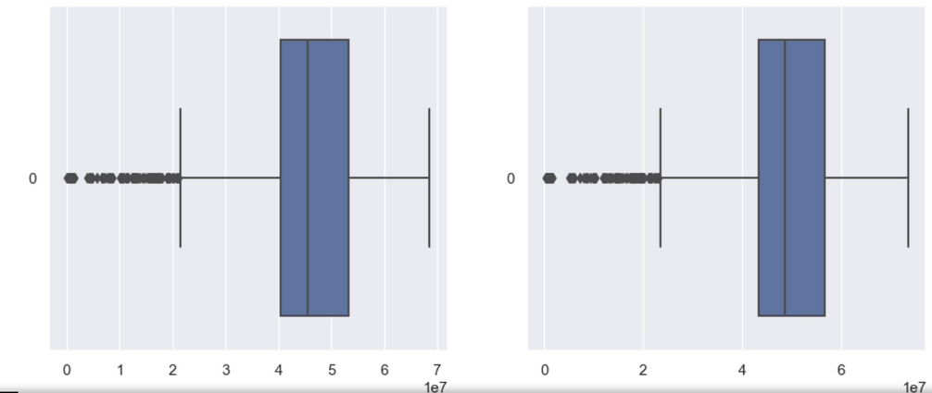
EDA
Plotting the distribution of numeric variables to observe any patterns (Boxplot and Histogram)
Insights: Observed that a few variable has extremely skewed distribuition which might cause biasness in the model. Hence, we drop them

Slide 12




Machine Learning
Random Forest
Logistic Regression
Artificial Neural Network

Slide 13
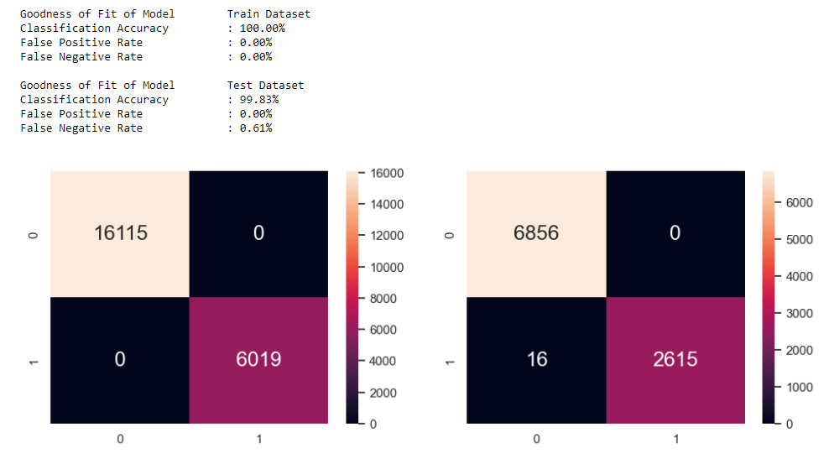
Random Forest
Random forests aim to reduce the overfitting problem of decision trees by averaging multiple trees, improving accuracy and robustness.
Train
Test

Slide 14
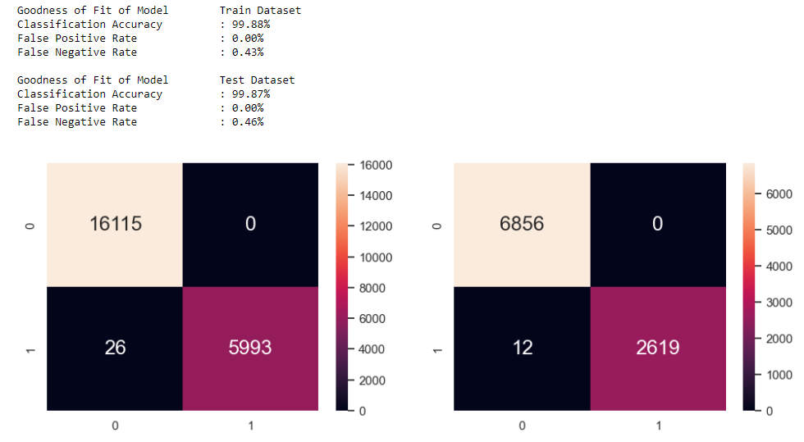
Logistic Regression
Logistic regression is a supervised machine learning algorithm that uses a logistic function for binary classification tasks
Train
Test

Slide 15
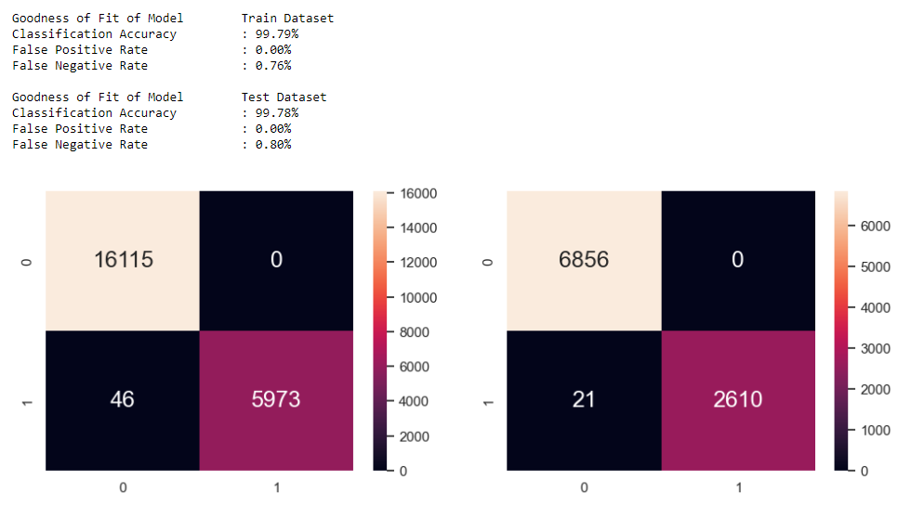
Artificial Neural Network
Neural network is a machine learning model inspired by the structure and function of biological neural networks in animal brains
Train
Test

Slide 16
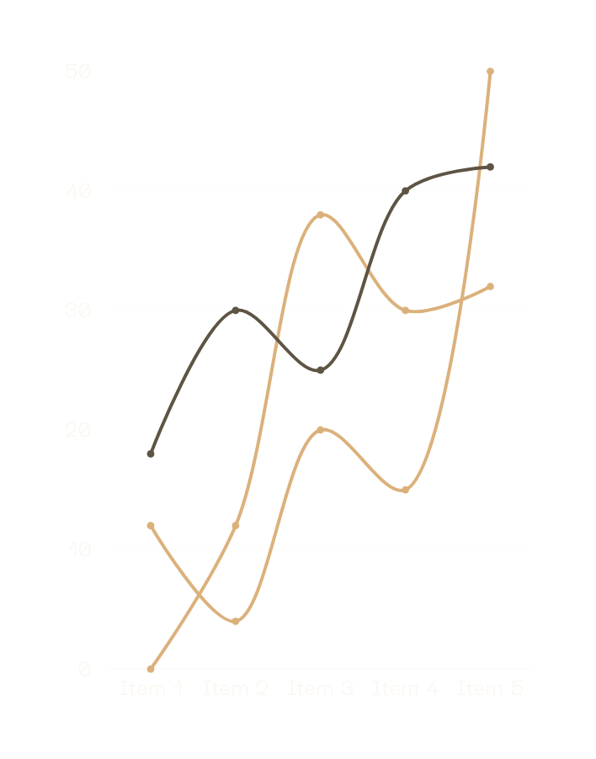
Refining the models
Removing outliers from the dataset

Slide 17
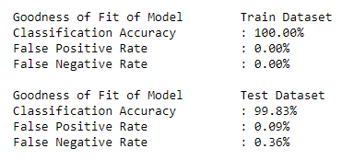
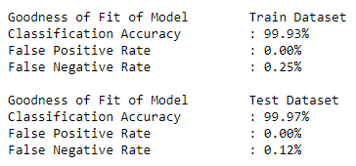
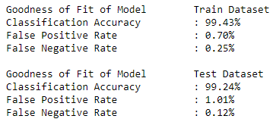
Results after removing outliers
Random Forest
Logistic Regression
Artificial Neural Network

Slide 18
Outcome
Optimal Threshold Probability
False Postive Rate vs False Negative Rate
Optimal threshold is: 79.234%
Categorising loan applicants
 | Actual | Predicted
Low Risk | 2172 | 2171
High Risk | 839 | 840

Slide 19

Conclusion
Credit risk modeling is designed to enhance a bank's capability to forecast potential loan defaults among its customers. By examining past loan data and predicting future risks, the bank can implement measures to mitigate its overall risk and boost its profitability.

